Slide 1
Improving Database Performance
Ahmed Hesham

Slide 2
Where to Store Databases
Databases can either write to the hard disk directly or through a file system
Databases that write directly to the hard disk keep track of the data on the disk, they implement an internal file system

Slide 3
What Are File Systems?
They are data structure to manage data on disk
Constitutes of clusters and extents
Access hard disk via block devices

Slide 4
What Are Block Devices?
These are buffered interfaces to a physical hardware
  Read/Write requests are placed in a queue in memory before being executed on disk
Example:
  On Linux, disks are accessed via the device path for example: /dev/sda is the buffered interface for disk “A”

Slide 5
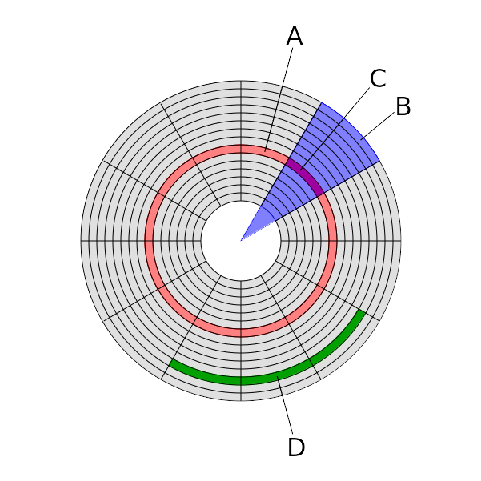
Hard Disk Layout
Hard disk is compromised of:
  Tracks (A)
  Geometrical Sector (B)
  Track sectors (C)
  Cluster (D)

Slide 6
Hard Disk - Track Sectors
Historically track sectors used to be of size 512 bytes
Modern hard disks can have track sectors of 4096 bytes (4KB)
4KB track sectors offer better error correction than 512 bytes as less sectors would be affected in the case of an error

Slide 7
Cluster
A sequence of bits containing a whole number of records stored on a block device
Typically clusters have a size of multiples of 512 or 4096 bytes, (depending on the OS and driver) that can span multiple track sectors

Slide 8
Extent
A contiguous area of storage reserved for a file in a file-system
Extent tree maps where the clusters of a file are
A file consists of 1 or more extents

Slide 9
Internal Fragmentation
A file does not necessarily have to be a multiple of 512 to fully occupy a sector which leads to unused space
Usually this is not handled

Slide 10
External Fragmentation
This occurs when a file’s clusters are not contiguous on the disk
This is typically handled through the use of Delayed Allocation

Slide 11
Delayed Allocation
The filesystem caches writes to the disk in the memory until memory pressure forces the cache to flush to the disk
This method reduces fragmentation by ensuring multiple writes to same file are grouped together

Slide 12
Old Generation File-systems
Most of file-systems used today are of the old generation group
Such file-systems do not employ data protection techniques against hardware failure nor do they offer a lot of features
Common examples:
  Linux: Ext4, XFS
  Mac: HFS, HFS+
  Windows: NTFS

Slide 13
XFS
Designed for parallel I/O through the use of allocation groups
Allocation groups are subvolumes of a file-system that each track their respective set of blocks and individual journal
Only one operation can happen on one group, but multiple groups can be operating simultaneously

Slide 14
XFS – continued
For parallel access to be possible, the underlying device must support parallel I/O for example: an SSD or RAID setup
Offers stellar data recovery through the use of a metadata journal and file journal

Slide 15
Next Generation File-systems
Recently added file-systems (within last decade)
Typically feature rich, e.g.:
  Data de-duplication
  Bit-rot protection
  Copy On Write
  Block Suballocation
Common Examples:
  Linux: BTRFS, ZFS
  Mac: AppleFS
  Windows: ReFS

Slide 16
BTRFS
Designed for data integrity and file versioning while providing a simple management interface
Internally uses a separate checksum tree to be able to regenerate files incase of corruption
Uses COW to provide file versions however, this introduces more fragmentation

Slide 17
BTRFS – continued
A single BTRFS volume can be further divided into sub-volumes and it internally manage itself

Slide 18
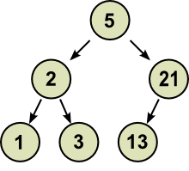
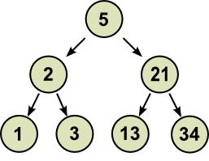
Copy On Write
COW provides immutable data structures
To add a new node (34) on the following binary tree if it was mutable

Slide 19
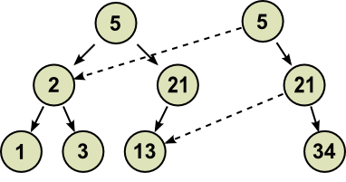
Copy On Write
In COW, the new tree would only contain the modified data with pointers to the original, thus the original tree can be restored

Slide 20
Copy On Write
COW harms performance when there are I/O intensive operations in a single file for instance database files or virtual machine files
Some file-systems offer the option to disable COW per directory

Slide 21
Data De-Duplication
It is possible that multiple copies of a file to exist on the same file-system
Instead of creating a new file for each copy, one file can be considered as the master and the other files can be pointers to the original

Slide 22
Data De-Duplication – continued
Two forms exist:
  Online de-duplication: runs in memory and may require large amounts of RAM depending on data on the disk to avoid thrashings
  Offline de-duplication: periodically invoked and entire filesystem is scanned for duplicate data

Slide 23
Checksum Trees
BTRFS keeps track of a checksum tree
Each node in the tree represents a directory/file checksum
If a file is corrupted, using the checksum tree it can be regenerated
By default BTRFS duplicates all of its meta-data on disk, therefore multiple checksum trees exist on disk incase a tree is corrupted

Slide 24
Block Sub-Allocation
Rather than let internal fragmentation occur, BTRFS and ZFS can fill partially used blocks with data from another file
Useful in databases where records sizes may not be of multiples of cluster sizes

Slide 25
Failure Recovery
RAID allows for multiple disks to be plugged together in an array to be viewed as one disk
RAID exists in 2 forms:
  Software: supported by the OS and some file-systems e.g. BTRFS and ZFS
  Hardware: special controller is installed on motherboard to enable RAID (faster than software RAID)
RAID exists in many levels to allow for different functionalities (2,3 and 4 are rarely used)

Slide 26
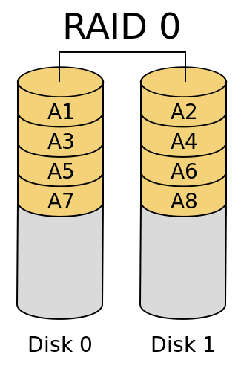
RAID 0
Most basic version of RAID
Simply evenly splits data between disks without fault tolerance or parity
The failure of 1 drive causes the entire array to fail

Slide 27
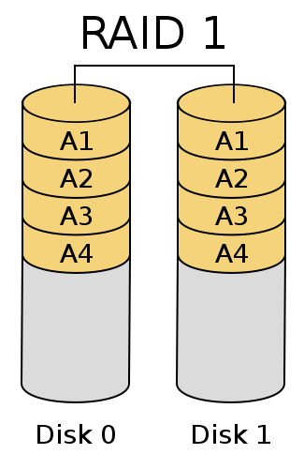
RAID 1
Mirrors disks content across the array without parity
The array continues to function as long as 1 drive remains operational
Mostly used when read performance is favoured over write performance

Slide 28
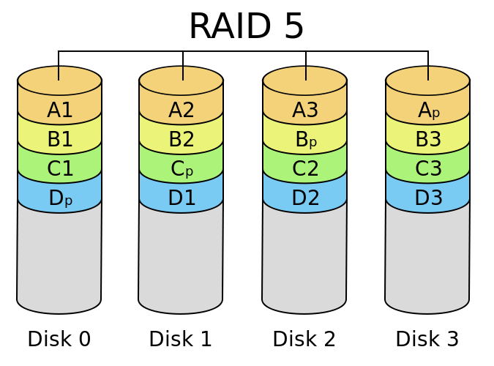
RAID 5
Disks are striped on block level with parity (minimum of 3 disks required)
Tolerates failure down to 2 disks in array
Data can be regenerated from distributed parity

Slide 29
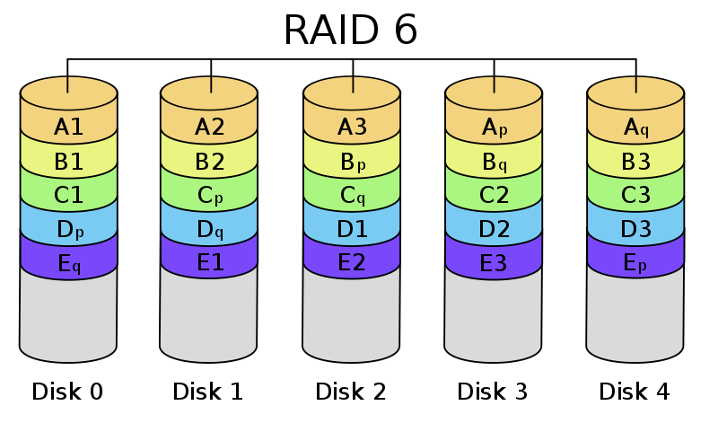
RAID 6
Extends RAID 5 but requires a minimum of 4 disks
Parity is striped to 2 disks instead of 1
Can withstand 2 disks failing simultaneously

Slide 30
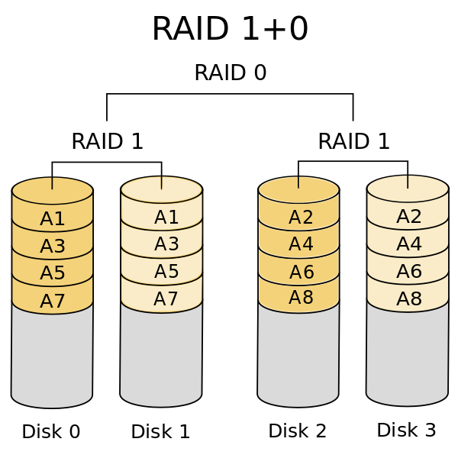
RAID 10 (RAID 1 + RAID 0)
Hybrid between levels 1 and 0
Offer striping and mirroring to the data across different levels
Requires at least 4 drives
Offers high transfer rates as data is duplicated

Slide 31
Performance Hits
While RAID reduces the potential possibility of data loss, it increases the latency of disk especially on writes
Reads can be substantially faster in RAID levels 1 and 10 since there is a replica of the data allowing for parallel reads of the data

Slide 32
Linux LVM
(Logical Volume Manager)
Embedded in the Linux kernel is a volume manager for disks
Enables separate disks to be used as 1 disk to allow for disk pools
A single pool can consist of multiple groups, each with a logical layer of its own
Allows for dynamic disk management by adding disks to the pool on the fly

Slide 33
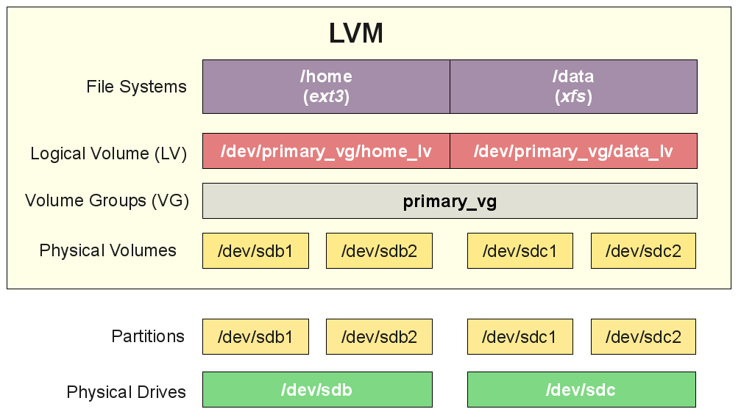
Linux LVM

Slide 34
Tiered Storage
Hard disks are the cheapest form of storage in the current market as they have low transistor count
Hard disks are extremely slow from the point of view of the processor therefore caching would benefit the disk
Not all content can be cached in memory such as media files for instance

Slide 35
Tiered Storage – continued
Hard disks are slow, they typically have speeds of around 7200 RPM for consumer grade and 15,000 RPM for enterprise
SSDs do not have mechanical parts thus offer speeds more than 10x that of HDDs
Two types of SSDs exist:
  NVME (Non Volatile Memory)
  SATA (Serial ATA Attachment)

Slide 36
NVME
These are a form of SSDs that are created from RAM modules, but with a special configuration that allows them to be non volatile
They are connected to the PCIe (Parallel Connection Interface extension) on the motherboard to allow parallel data streams (typically 1 byte per disk access)
Most expensive disk

Slide 37
SATA SSDs
Non mechanical disks that are connected serially to the motherboard
Still offer a substantial gain over HDDs as there is no alignment of mechanical pieces involved
Allow for parallel data access through multiple cores accessing it at same time (XFS shines here and on NVME)

Slide 38
Disk Caching
Linux LVM offers tiered storage by specifying which devices to use as a cache to the HDDs
Multiple caching modes exist:
  Write-through: ensures new data is written on both disks
  Write-back: offers higher performance by writing to faster device and writing to slower disk when cache needs to be evicted but higher risk of data loss if cache fails

